Slide 1




IBM Blockchain Foundation
LING Zong, Ph. D.
Senior Software Engineer / Scientist
IBM Almaden Research Center
San Jose, California, U.S.A.
©2017 IBM Corporation
Notes:
https://hyperledger-fabric.readthedocs.io/en/latest/

Slide 2
What is a business blockchain network?
A business blockchain network is a decentralized network that uses distributed ledger technology (DLT) for the efficient and secure transfer of business assets between member organizations in the network. Assets can be physical or digital, such as vehicles, diamonds, fresh produce, or insurance records. A shared, distributed ledger records an immutable history of all asset transactions between participants in the network, and catalogs the current state (world state) of those assets. The business rules that govern transactions are agreed upon by members and encapsulated in smart contracts.
Instead of relying on a central authority or trusted intermediary, such as a bank or brokerage firm, to validate transactions, members of a blockchain network use a consensus mechanism to improve transaction processing speed, transparency, and accountability across the network. For additional confidentiality, members join one or more channels that allow for data isolation; a channel-specific ledger is shared by the authenticated peers in that channel.
A blockchain network for business is collectively owned and operated by a group of identifiable and verifiable institutions, such as businesses, universities, or hospitals. In such a permissioned network, the participants are known to each other, and transactions are processed much faster than in a non-permissioned, public network like the Bitcoin network. In the Bitcoin network, members are anonymous, forcing the reliance on “proof-of-work” and other types of consensus mechanisms that require time-consuming computations to confirm identities and validate transactions.

Slide 3
Topics
Blockchain Architecture
Blockchain Fabric Development
Blockchain Components
Blockchain Operations
Hyperledger Composer
Notes:
https://www.ibm.com/cloud/architecture/architectures/blockchainArchitecture

Slide 4
Blockchain Architecture
©2017 IBM Corporation
Notes:
https://www.ibm.com/cloud/architecture/architectures/blockchainArchitecture

Slide 5
Blockchain provides a single version of truth
Blockchain is a shared ledger technology that participants in a business network can use to record the history of business transactions that cannot be altered.
Blockchain provides a single point of truth: a shared, tamper-evident ledger.
This approach changes transaction tracking from a siloed model, where multiple ledgers are maintained separately, to one that provides a common view across the entire network.
The new Blockchain for Dummies has use cases that describe real blockchain networks, the latest from the IBM Blockchain Platform, and more.
Because blockchain uses consensus to commit transactions to the ledger, the results are final. Each member has a copy of the same ledger, so asset provenance and traceability are transparent and trusted. Blockchain can be applied to any industry.
Notes:
https://www.ibm.com/cloud/architecture/architectures/blockchainArchitecture

Slide 6
The power of blockchain
Blockchain empowers enterprises in several ways:
Use the power of ecosystems to complete transactions faster with greater trust.
Vastly reduce the cost and complexity of cross-enterprise business processes by eliminating inefficiencies, waste, and duplication.
Support the invention of new styles of digital interactions.
Reduce friction and inefficiencies in the market, freeing capital.
Create cost-efficient business networks where virtually anything of value can be tracked and traded without requiring a central point of control.
Decrease transaction cycle times by addressing risk and uncertainty.
Reduce fraud from e-crime and cyber attacks.
Notes:
https://www.ibm.com/cloud/architecture/architectures/blockchainArchitecture

Slide 7


Security: Public vs. Private Blockchains
Public blockchains
For example, Bitcoin
Transactions are viewable by anyone
Participant identity is more difficult to control
Private blockchains
For example, Hyperledger Fabric
Network members are known but transactions are secret
Some use cases require anonymity, others require privacy
Some may require a mixture of the two, depending on the characteristics of each participant
Most business use cases require private, permissioned blockchains
Network members know who they’re dealing with (required for KYC, AML, etc.)
Transactions are (usually) confidential between the participants concerned
Membership is controlled
Notes:
KYC规则是指了解客户(know-your-customer, KYC)规则。金融机构如不能清晰识别客户身份，便更不愿贷款给客户，阻碍金融普惠，是国际社会努力实现金融诚信和金融普惠不可或缺的。
AML anti-money laundering

Slide 8

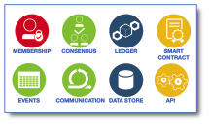




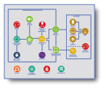






Blockchain architecture
WALLET
(EXTERNAL)
TRUSTED
EXTERNAL
SYSTEMS
DEVICE
EVENT
LISTNER
IDENTITY &
ACCESS
MANAGEMENT
WALLET
USER
BROWSER
EDGE
SERVICES
NODE J
IoT
DEVICES
APPLICATION
LOGIC
MESSAGE
BUS
TRANSACTION
MANAGER
NODE I
NODE N
NODE K
ENTERPRISE
APPLICATIONS
TRANSFORMATION &
CONNECTIVITY
ANALYTICS
DATA STORE
OFF CHAIN
GOVERNANCE
SECURITY
SYSTEM
MANAGEMENT
DEVOPS

Slide 9
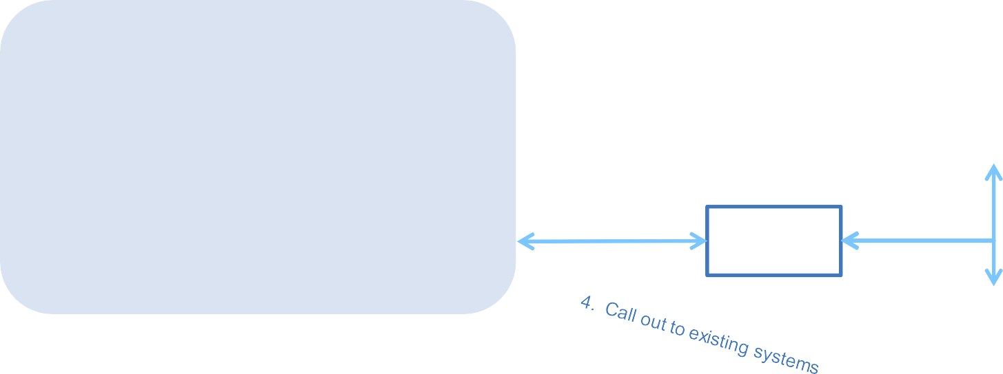











Integrating with Existing Systems
2. Blockchain events
1. System events
!
!
Existing systems
3. Call into blockchain network
from existing systems
Transform
Blockchain network
Existing systems

Slide 10
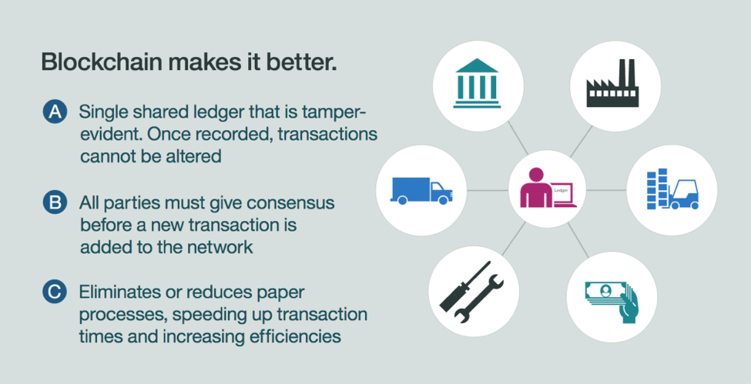
The power of blockchain
Notes:
https://www.ibm.com/cloud/architecture/architectures/blockchainArchitecture

Slide 11
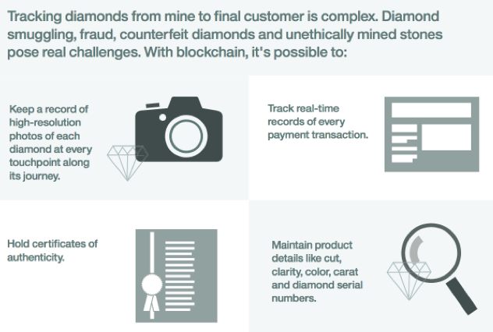
Blockchain in action: The diamond industry
To understand the value of a blockchain, consider a practical example. The diamond industry faces many challenges, including smuggling, fraud, counterfeit diamonds, and unethically mined stones. A blockchain can be used to mitigate some of those challenges.
The journey from mine to consumer covers a complex journey through legal, regulatory, financial, manufacturing, and commercial practices. Challenges exist every step of the way. Consumers run the risk of buying unethically mined diamonds. Governments must track diamond exports and pay export taxes. Customers want to be sure that they’re getting the diamonds that they’re paying for.
The use of a blockchain can eliminate vulnerabilities through transparent transactions. All parties have access to a secure, synchronized record of transactions. The ledger records every sequence of transactions, from beginning to end.
Blockchain can record the mining, refining, and distribution of diamonds. A diamond’s path can be traced from the mine to the hands of the consumer with security and transparency.
The ledger keeps the diamond’s records, including high-resolution photos at each block of the chain, from where it’s excavated in the mine, to where it’s cut and refined, to where it’s sold.
The blockchain holds certificates of authenticity, payment transactions, and detailed characteristics of the diamond, including color, cut, clarity, carat, and the diamond serial number. At the end of a buying cycle, the diamond has a complete, auditable, undisputable record of information.
①
②
④
③
Notes:
https://www.ibm.com/cloud/architecture/architectures/blockchainArchitecture

Slide 12
Blockchain Fabric Development
©2017 IBM Corporation

Slide 13
Requirements for Enterprise BlockChain
For enterprise use, we need to consider the following requirements:
Participants must be identified/identifiable
Networks need to be permissioned
High transaction throughput performance
Low latency of transaction confirmation
Privacy and confidentiality of transactions and data pertaining to business transactions
While many early blockchain platforms are currently being adapted for enterprise use, Hyperledger Fabric has been designed for enterprise use from the outset.
Notes:
https://hyperledger-fabric.readthedocs.io/en/latest/whatis.html

Slide 14
Hyperledger Fabric Concepts (1)
Hyperledger Fabric is an open source enterprise-grade permissioned distributed ledger technology (DLT) platform, designed for use in enterprise contexts, that delivers some key differentiating capabilities over other popular distributed ledger or blockchain platforms.
One key point of differentiation is that Hyperledger was established under the Linux Foundation, which itself has a long and very successful history of nurturing open source projects under open governance that grow strong sustaining communities and thriving ecosystems.
Hyperledger is governed by a diverse technical steering committee, and the Hyperledger Fabric project by a diverse set of maintainers from multiple organizations. It has a development community that has grown to over 35 organizations and nearly 200 developers since its earliest commits.
Fabric has a highly modular and configurable architecture, enabling innovation, versatility and optimization for a broad range of industry use cases including banking, finance, insurance, healthcare, human resources, supply chain and even digital music delivery.
Fabric is the first distributed ledger platform to support smart contracts authored in general-purpose programming languages such as Java, Go and Node.js, rather than constrained domain-specific languages (DSL). This means that most enterprises already have the skill set needed to develop smart contracts, and no additional training to learn a new language or DSL is needed.
The Fabric platform is also permissioned, meaning that, unlike with a public permissionless network, the participants are known to each other, rather than anonymous and therefore fully untrusted.
This means that while the participants may not fully trust one another (they may, for example, be competitors in the same industry), a network can be operated under a governance model that is built off of what trust does exist between participants, such as a legal agreement or framework for handling disputes.
Notes:
https://hyperledger-fabric.readthedocs.io/en/latest/whatis.html

Slide 15
Hyperledger Fabric Concepts (2)
One of the most important of the platform’s differentiators is its support for pluggable consensus protocols that enable the platform to be more effectively customized to fit particular use cases and trust models.
For instance, when deployed within a single enterprise, or operated by a trusted authority, fully byzantine fault tolerant consensus might be considered unnecessary and an excessive drag on performance and throughput. In situations such as that, a crash fault-tolerant (CFT) consensus protocol might be more than adequate whereas, in a multi-party, decentralized use case, a more traditional byzantine fault tolerant (BFT) consensus protocol might be required.
Fabric can leverage consensus protocols that do not require a native cryptocurrency to incent costly mining or to fuel smart contract execution.
Avoidance of a cryptocurrency reduces some significant risk/attack vectors, and absence of cryptographic mining operations means that the platform can be deployed with roughly the same operational cost as any other distributed system.
The combination of these differentiating design features makes Fabric one of the better performing platforms available today both in terms of transaction processing and transaction confirmation latency, and it enables privacy and confidentiality of transactions and the smart contracts (what Fabric calls “chaincode”) that implement them.
Let’s explore these differentiating features in more detail.
Notes:
https://hyperledger-fabric.readthedocs.io/en/latest/whatis.html

Slide 16
Modularity
Hyperledger Fabric has been specifically architected to have a modular architecture. Whether it is pluggable consensus, pluggable identity management protocols such as LDAP or OpenID Connect, key management protocols or cryptographic libraries, the platform has been designed at its core to be configured to meet the diversity of enterprise use case requirements. At a high level, Fabric is comprised of the following modular components:
A pluggable ordering service establishes consensus on the order of transactions and then broadcasts blocks to peers.
A pluggable membership service provider is responsible for associating entities in the network with cryptographic identities.
An optional peer-to-peer gossip service disseminates the blocks output by ordering service to other peers.
Smart contracts (“chaincode”) run within a container environment (e.g. Docker) for isolation. They can be written in standard programming languages but do not have direct access to the ledger state.
The ledger can be configured to support a variety of DBMSs.
A pluggable endorsement and validation policy enforcement that can be independently configured per application.
There is fair agreement in the industry that there is no “one blockchain to rule them all”. Hyperledger Fabric can be configured in multiple ways to satisfy the diverse solution requirements for multiple industry use cases.
Notes:
https://hyperledger-fabric.readthedocs.io/en/latest/whatis.html

Slide 17
Permissioned vs Permissionless Blockchains
In a permissionless blockchain, virtually anyone can participate, and every participant is anonymous. In such a context, there can be no trust other than that the state of the blockchain, prior to a certain depth, is immutable. In order to mitigate this absence of trust, permissionless blockchains typically employ a “mined” native cryptocurrency or transaction fees to provide economic incentive to offset the extraordinary costs of participating in a form of byzantine fault tolerant consensus based on “proof of work” (PoW).
Permissioned blockchains, on the other hand, operate a blockchain amongst a set of known, identified and often vetted participants operating under a governance model that yields a certain degree of trust.
A permissioned blockchain provides a way to secure the interactions among a group of entities that have a common goal but which may not fully trust each other.
By relying on the identities of the participants, a permissioned blockchain can use more traditional crash fault tolerant (CFT) or byzantine fault tolerant (BFT) consensus protocols that do not require costly mining.
Additionally, in such a permissioned context, the risk of a participant intentionally introducing malicious code through a smart contract is diminished.
First, the participants are known to one another and all actions, whether submitting application transactions, modifying the configuration of the network or deploying a smart contract are recorded on the blockchain following an endorsement policy that was established for the network and relevant transaction type.
Rather than being completely anonymous, the guilty party can be easily identified and the incident handled in accordance with the terms of the governance model.
Notes:
https://hyperledger-fabric.readthedocs.io/en/latest/whatis.html

Slide 18
Smart Contracts
A smart contract, or what Fabric calls “chaincode”, functions as a trusted distributed application that gains its security/trust from the blockchain and the underlying consensus among the peers. It is the business logic of a blockchain application.
There are three key points that apply to smart contracts, especially when applied to a platform:
many smart contracts run concurrently in the network,
they may be deployed dynamically (in many cases by anyone), and
application code should be treated as untrusted, potentially even malicious.
Most existing smart-contract capable blockchain platforms follow an order-execute architecture in which the consensus protocol:
validates and orders transactions then
propagates them to all peer nodes
each peer then executes the transactions sequentially.
The order-execute architecture can be found in virtually all existing blockchain systems, ranging from public/permissionless platforms such as Ethereum (with PoW-based consensus) to permissioned platforms such as Tendermint, Chain, and Quorum.
Smart contracts executing in a blockchain that operates with the order-execute architecture must be deterministic; otherwise, consensus might never be reached. To address the non-determinism issue, many platforms require that the smart contracts be written in a non-standard, or domain-specific language (such as Solidity) so that non-deterministic operations can be eliminated. This hinders wide-spread adoption because it requires developers writing smart contracts to learn a new language and may lead to programming errors.
Further, since all transactions are executed sequentially by all nodes, performance and scale is limited. The fact that the smart contract code executes on every node in the system demands that complex measures be taken to protect the overall system from potentially malicious contracts in order to ensure resiliency of the overall system.
Notes:
https://hyperledger-fabric.readthedocs.io/en/latest/whatis.html

Slide 19
A New Approach in Fabric
Fabric introduces a new architecture for transactions that we call execute-order-validate. It addresses the resiliency, flexibility, scalability, performance and confidentiality challenges faced by the order-execute model by separating the transaction flow into three steps:
execute a transaction and check its correctness, thereby endorsing it,
order transactions via a (pluggable) consensus protocol, and
validate transactions against an application-specific endorsement policy before committing them to the ledger
This design departs radically from the order-execute paradigm in that Fabric executes transactions before reaching final agreement on their order.
In Fabric, an application-specific endorsement policy specifies which peer nodes, or how many of them, need to vouch for the correct execution of a given smart contract. Thus, each transaction need only be executed (endorsed) by the subset of the peer nodes necessary to satisfy the transaction’s endorsement policy. This allows for parallel execution increasing overall performance and scale of the system. This first phase also eliminates any non-determinism, as inconsistent results can be filtered out before ordering.
Because we have eliminated non-determinism, Fabric is the first blockchain technology that enables use of standard programming languages.
Notes:
https://hyperledger-fabric.readthedocs.io/en/latest/whatis.html

Slide 20
Privacy and Confidentiality - Problems
In a public, permissionless blockchain network that leverages PoW for its consensus model, transactions are executed on every node. This means that neither can there be confidentiality of the contracts themselves, nor of the transaction data that they process. Every transaction, and the code that implements it, is visible to every node in the network. In this case, we have traded confidentiality of contract and data for byzantine fault tolerant consensus delivered by PoW.
This lack of confidentiality can be problematic for many business/enterprise use cases.
For example, in a network of supply-chain partners, some consumers might be given preferred rates as a means of either solidifying a relationship, or promoting additional sales. If every participant can see every contract and transaction, it becomes impossible to maintain such business relationships in a completely transparent network — everyone will want the preferred rates!
As a second example, consider the securities industry, where a trader building a position (or disposing of one) would not want her competitors to know of this, or else they will seek to get in on the game, weakening the trader’s gambit.
In order to address the lack of privacy and confidentiality for purposes of delivering on enterprise use case requirements, blockchain platforms have adopted a variety of approaches. All have their trade-offs.
Notes:
https://hyperledger-fabric.readthedocs.io/en/latest/whatis.html

Slide 21
Privacy and Confidentiality – Solutions (Channel)
Encrypting data is one approach to providing confidentiality; however, in a permissionless network leveraging PoW for its consensus, the encrypted data is sitting on every node. Given enough time and computational resource, the encryption could be broken. For many enterprise use cases, the risk that their information could become compromised is unacceptable.
Zero knowledge proofs (ZKP) are another area of research being explored to address this problem, the trade-off here being that, presently, computing a ZKP requires considerable time and computational resources. Hence, the trade-off in this case is performance for confidentiality.
In a permissioned context that can leverage alternate forms of consensus, one might explore approaches that restrict the distribution of confidential information exclusively to authorized nodes.
Hyperledger Fabric, being a permissioned platform, enables confidentiality through its channel architecture and private data feature.
In channels, participants on a Fabric network establish a sub-network where every member has visibility to a particular set of transactions.
Thus, only those nodes that participate in a channel have access to the smart contract (chaincode) and data transacted, preserving the privacy and confidentiality of both.
Private data allows collections between members on a channel, allowing much of the same protection as channels without the maintenance overhead of creating and maintaining a separate channel.
Notes:
https://hyperledger-fabric.readthedocs.io/en/latest/whatis.html

Slide 22
Pluggable Consensus
The ordering of transactions is delegated to a modular component for consensus that is logically decoupled from the peers that execute transactions and maintain the ledger.
Specifically, the ordering service. Since consensus is modular, its implementation can be tailored to the trust assumption of a particular deployment or solution. This modular architecture allows the platform to rely on well-established toolkits for CFT (crash fault-tolerant) or BFT (byzantine fault-tolerant) ordering.
Fabric currently offers a CFT ordering service implementation based on the etcd library of the Raft protocol.
etcd is a strongly consistent, distributed key-value store that provides a reliable way to store data that needs to be accessed by a distributed system or cluster of machines - https://etcd.io
Raft is a consensus algorithm that is designed to be easy to understand - https://raft.github.io
For information about currently available ordering services, check out this conceptual documentation about ordering.
Note also that these are not mutually exclusive. A Fabric network can have multiple ordering services supporting different applications or application requirements.
Notes:
https://hyperledger-fabric.readthedocs.io/en/latest/whatis.html

Slide 23
Performance and Scalability
Performance of a blockchain platform can be affected by many variables such as transaction size, block size, network size, as well as limits of the hardware, etc. The Hyperledger Fabric Performance and Scale working group currently works on a benchmarking framework called Hyperledger Caliper.
Several research papers have been published studying and testing the performance capabilities of Hyperledger Fabric.
The latest scaled Fabric to 20,000 transactions per second.
Any serious evaluation of blockchain platforms should include Hyperledger Fabric in its short list.
Combined, the differentiating capabilities of Fabric make it a highly scalable system for permissioned blockchains supporting flexible trust assumptions that enable the platform to support a wide range of industry use cases ranging from government, to finance, to supply-chain logistics, to healthcare and so much more.
Hyperledger Fabric is the most active of the Hyperledger projects. The community building around the platform is growing steadily, and the innovation delivered with each successive release far out-paces any of the other enterprise blockchain platforms.
Notes:
https://hyperledger-fabric.readthedocs.io/en/latest/whatis.html

Slide 24
Blockchain Components
©2017 IBM Corporation
Notes:
https://developer.ibm.com/technologies/blockchain/

Slide 25
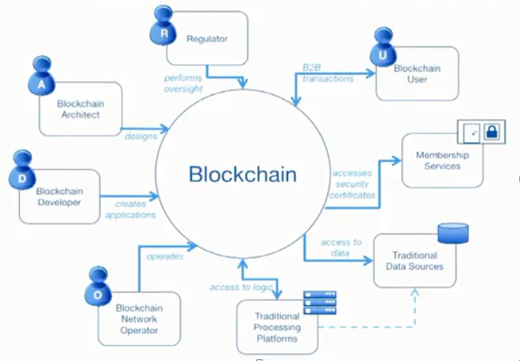
Participants & components overview
Who are the participants in a blockchain network
Notes:
https://developer.ibm.com/courses/all/ibm-blockchain-foundation-developer/?course=begin#11982

Slide 26
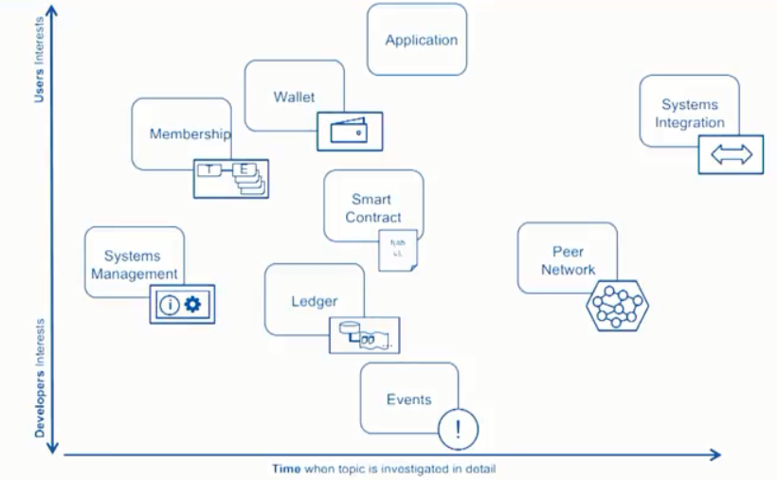
Components in a Blockchain
Ecerts (enrollment certificates) identify individuals in a network.
Tcerts (transaction certificates) capture the events of a transaction.
Anyone in the network can look up an Ecert or Tcert.
Notes:
https://developer.ibm.com/courses/all/ibm-blockchain-foundation-developer/?course=begin#11982

Slide 27


Actors in a Blockchain Solution (1)
The actors represent entities that exist outside the scope of the solution, but are critical for its completeness.
For example, actors can be people, devices, external institutions, legacy applications that will not be modified by this solution, and packaged applications with which this solution will interact.
R
Regulator
U
B2B
transactions
Blockchain User
A
performs oversight
Blockchain Architect
✓
designs
Membership Services
Blockchain
accesses security certificates
D
Blockchain Developer
creates
applications
access to data
operates
Traditional
Data Sources
O
access to logic
Blockchain Network Operator
Traditional Processing Platforms

Slide 28





Actors in a Blockchain Solution (2)
Blockchain Architect
Responsible for the architecture and design of the blockchain solution
A
The business user, operating in a business network. This role interacts with the Blockchain using an application.
They are not aware of the Blockchain.
Blockchain User
U
Blockchain
Regulator
The overall authority in a business network. Specifically, regulators may require broad access to the ledger’s contents.
R
Blockchain Developer
The developer of applications and smart contracts that interact with the Blockchain and are used by Blockchain users.
D
Blockchain Operator
Manages and monitors the Blockchain network. Each business in the network has a Blockchain Network operator.
O
Membership Services
✓
Manages the different types of certificates required to run a permissioned Blockchain.
Traditional Processing Platform
An existing computer system which may be used by the Blockchain to augment processing.
This system may also need to initiate requests into the Blockchain.
Traditional Data Sources
An existing data system which may provide data to influence the behavior of smart contracts.

Slide 29




Components in a Blockchain Solution
Ledger
…
A ledger is a channel’s chain and current state data which is maintained by each peer on the channel.
f(abc);
Software running on a ledger, to encode assets and transaction instructions (business logic) for modifying the assets.
Smart Contract
Peer Network
A broader term overarching the entire transactional flow, which serves to generate an agreement on the order and to confirm the correctness of the set of transactions constituting a block.
Membership
E T
Membership Services authenticates, authorizes, and manages identities on a permissioned blockchain network.
Events
!
Creates notifications of significant operations on the blockchain (e.g. a new block), as well as notifications related to smart contracts.
Systems Management
i
Provides the ability to create, change and monitor blockchain components
Wallet
Securely manages a user’s security credentials
Systems Integration
Responsible for integrating Blockchain bi-directionally with external systems. Not part of blockchain, but used with it.

Slide 30










The Blockchain Developers
D
Blockchain Developer
Blockchain developers’ primary interests are…
Application
Smart Contract
f(abc);
…and how they interact with the ledger and other systems of record:
Traditional Processing Platforms
Traditional Data Sources
Systems Integration
Ledger
Events
…
!
They should NOT have to care about operational concerns, such as:
X
Peers Consensus Security
Notes:
Within Hyperledger Fabric, a developer is going to need to really understand the application and smart contract. Here we look at an example the blockchain and world state in the ledger with how this integrates with the smart contract and application. The developer will also going to be understanding built in integration method such as events, transformation and calling out directly from the smart contract with this last option having the possible issue on non-deterministic results which will not reach a consensus

Slide 31
How the Developer Interacts with the Ledger
A ledger often consists of two data structures
Blockchain
block
A linked list of blocks
Each block describes a set of transactions
(e.g. the inputs to a smart contract invocation)
Immutable – blocks cannot be tampered
txn
txn
txn
Blockchain
World State
An ordinary database (e.g. key/value store)
Stores the combined outputs of all transactions
Not usually immutable
World state

Slide 32


Working with the Ledger Example of a Change of Ownership Transaction (change car1 owner to Matt)
Transaction input - sent from application
invoke(myContract, setOwner, myCar, Matt)
Application
Smart contract implementation
setOwner(Car, newOwner) {
set Car.owner = newOwner
}
Smart
Contract
f(abc);
World state: new contents
myCar.vin = 1234 myCar.owner = Matt myCar.make = Audi
…
myCar.vin = 1234, ...
txn
txn
txn
World state
“Invoke, myContract, setOwner, myCar, Matt”

Slide 33





The Blockchain Administrators (Operators)
O
Blockchain Administrator
Blockchain administrators’ primary interests are in the deployment and operation of part of the blockchain:
Peers
Consensus
Security
✓
They should NOT have to care about development concerns, such as:
X
Application code
Smart contract code
Events and integration

Slide 34
Consensus: The Process of Maintaining a Consistent Ledger
before
after
ABC
DEF
ABC
ABC
CONSENSUS
ABC
JKL
ABC
JKL
Keep all peers up to date.
Fix any peers in error.
Ignore all malicious nodes.
peer
LEDGER

Slide 35






Consensus: Typical Flow of Execution
Details vary significantly between blockchain implementations, but a typical flow is:
△?
△?
△
△?
△?
△ ?
△?
△?
△?
The application submits a request to invoke a transaction
The transaction is shared around the network
A designated peer creates a block containing the transaction
The block’s transactions are executed and output stored in a delta
The network attempts to agree on the correct result
If there is agreement, the correct output is applied to the world state
The process to agree the consistent state of the ledger is known as consensus

Slide 36






Some Examples of Consensus Algorithms
Proof of work
Proof of stake
Solo
Kafka/
Zookeeper
Proof of
Elapsed Time
PBFT-based
Notes:
https://www.investopedia.com/terms/p/proof-elapsed-time-cryptocurrency.asp
https://www.blockchain-council.org/blockchain/solo-mining-works/

Slide 37






Consensus Algorithms have Different Strengths and Weaknesses
Require validators to solve difficult cryptographic puzzles
PROs: Works in untrusted networks, CONS: Relies on energy use; slow to confirm transactions
Example usage: Bitcoin, Ethereum
Proof of work
Require validators to hold currency in escrow
PROs: Works in untrusted networks, CONS: Requires intrinsic (crypto)currency, ”Nothing at stake” problem
Example usage: Nxt, https://nxtplatform.org
Proof of stake
Wait time in a trusted execution environment randomizes block generation
PROs: Efficient, CONS: Currently tailored towards one vendor
Example usage: Sawtooth-Lake, https://sawtooth.hyperledger.org
Proof of
Elapsed Time
Validators apply received transactions without consensus
PROs: Very quick; suited to development, CONS: No consensus; can lead to divergent chains
Example usage: Hyperledger Fabric V1
Solo
Practical Byzantine Fault Tolerance implementations
PROs: Reasonably efficient and tolerant against malicious peers, CONS: Validators are known and totally connected
Example usage: Hyperledger Fabric V0.6
PBFT-based
Kafka/
Zookeeper
Ordering service distributes blocks to peers
PROs: Efficient and fault tolerant, CONS: Does not guard against malicious activity
Example usage: Hyperledger Fabric V1

Slide 38


Certificate Authorities and Blockchain
Blockchain User A
Blockchain User B
Certificate Authority
Certs
requests certificates
U
U
issues certificates
uses
uses
signs / encrypts transactions
Client Application
Client
Application
R
SDK
verifies/decrypts transactions
SDK
Blockchain

Slide 39
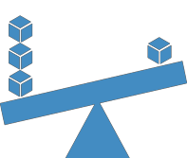
Other Nonfunctional Requirements
Performance
The amount of data being shared
Number and location of peers
Latency and throughput
Batching characteristics
Security
Type of data being shared, and with whom
How is identity achieved
Confidentiality of transaction queries
Who verifies (endorses) transactions
Resiliency
Resource failure
Malicious activity
Non-determinism
Consider the trade-offs between performance, security, and resiliency!

Slide 40
Blockchain Operations
©2017 IBM Corporation

Slide 41


Nodes and Roles in Hyperledger Fabric
 | Committing Peer: Maintains ledger and state. Commits transactions. May hold smart contract (chaincode).
 | Endorsing Peer: Specialized committing peer that receives a transaction proposal for endorsement, responds granting or denying endorsement. Must hold smart contract
 | Ordering Nodes (service): Approves the inclusion of transaction blocks into the ledger and communicates with committing and endorsing peer nodes. Does not hold smart contract. Does not hold ledger.

Slide 42


















Sample Transaction: Step 1/7 – Propose Transaction
Application proposes transaction
E₀
P₃
P₄
Endorsement policy:
“E_{0,} E₁ and E₂ must sign”
(P₃, P₄ are not part of the policy)
A
B
A
D
Client application submits a transaction
proposal for Smart Contract A. It must
Client Application
S D K
E₁
O
O
target the required peers {E , E , E }.
0 1 2
A
B
E
P
O
O
Key:
2
Endorser |  |  |  |  |  | Ledger
Committing Peer |  |  |  |  |  | Application
Ordering Node
Smart Contract (Chaincode) |  |  |  |  |  | Endorsement Policy
A
B
Ordering Service
Hyperledger Fabric

Slide 43

Sample Transaction: Step 2/7 – Execute Proposal
Endorsers Execute Proposals
E₀
P₃
P₄
E₀, E₁ & E₂ will each execute the proposed transaction. None of these executions will update the ledger.
A
B
A
D
Each execution will capture the set of Read and Written data, called RW sets, which will now flow in the fabric.
Client Application
S D K
E₁
O
O
A
B
Transactions can be signed and encrypted.
Key:
E
P
O
O
2
Endorser |  |  |  |  |  | Ledger
Committing Peer |  |  |  |  |  | Application
Ordering Node
Smart Contract (Chaincode) |  |  |  |  |  | Endorsement Policy
A
B
Ordering Service
Hyperledger Fabric

Slide 44
Sample Transaction: Step 3/7 – Proposal Response
Application receives responses
E₀
P₃
P₄
RW sets are asynchronously returned to
application.
A
B
A
D
The RW sets are signed by each endorser, and also includes each record version number.
Client Application
S D K
E
1
O
O
A
This information will be checked much later in the consensus process.
B
E
P
O
O
Key:
2
Endorser |  |  |  |  |  | Ledger
Committing Peer |  |  |  |  |  | Application
Ordering Node
Smart Contract (Chaincode) |  |  |  |  |  | Endorsement Policy
A
B
Ordering Service
Hyperledger Fabric
Notes:
https://hyperledger-fabric.readthedocs.io/en/latest/readwrite.html
Transaction validation and updating world state using read-write set
The read set contains a list of unique keys and their committed version numbers (but not values) that the transaction reads during simulation. The write set contains a list of unique keys (though there can be overlap with the keys present in the read set) and their new values that the transaction writes.

Slide 45
Sample Transaction: Step 4/7 – Order Transaction
Application submits responses for
ordering
E₀
P₃
P₄
Application submits responses as a transaction to be ordered.
A
B
A
D
Ordering happens across the fabric in parallel with transactions submitted by other applications.
Client Application
S D K
E
1
O
O
A
B
E
P
O
O
Key:
2
Endorser |  |  |  |  |  | Ledger
Committing Peer |  |  |  |  |  | Application
Ordering Node
Smart Contract (Chaincode) |  |  |  |  |  | Endorsement Policy
A
B
Ordering Service
Hyperledger Fabric
(other applications)

Slide 46
Sample Transaction: Step 5/7 – Deliver Transaction
Orderer delivers to all committing peers
E₀
P₃
P₄
Ordering service collects transactions into proposed blocks for distribution to committing peers. Peers can deliver to other peers in a hierarchy (not shown).
A
B
A
D
*
Client Application
S D K
E
Different ordering algorithms available:
SOLO (Single node, development)
Kafka (Crash fault tolerance)
1
O
O
A
B
E
P
O
O
Key:
2
Endorser |  |  |  |  |  | Ledger
Committing Peer |  |  |  |  |  | Application
Ordering Node
Smart Contract (Chaincode) |  |  |  |  |  | Endorsement Policy
A
B
Ordering Service
Hyperledger Fabric

Slide 47



Sample Transaction: Step 6/7 – Validate Transaction
Committing peers validate transactions
E₀
P₃
P₄
Every committing peer validates against the endorsement policy. Also check RW sets are still valid for current world state.
*
A
B
*
A
D
*
Validated transactions are applied to the world state and retained on the ledger.
Client Application
S D K
E
1
O
O
A
Invalid transactions are also retained on the ledger but do not update world state.
*
B
E
P
O
O
Key:
2
Endorser |  |  |  |  |  | Ledger
Committing Peer |  |  |  |  |  | Application
Ordering Node
Smart Contract (Chaincode) |  |  |  |  |  | Endorsement Policy
*
A
B
Ordering Service
Hyperledger Fabric

Slide 48







Sample Transaction: Step 7/7 – Notify Transaction
Committing peers notify applications
!
E₀
!
P₃
!
P₄
Applications can register to be notified when transactions succeed or fail and when blocks are added to the ledger.
A
B
A
D
Applications will be notified by each peer to which they are connected.
Client Application
S D K
!
E
!
1
O
O
A
B
E₂
P
O
O
Key:
!
Endorser |  |  |  |  |  | Ledger
Committing Peer |  |  |  |  |  | Application
Ordering Node
Smart Contract (Chain code) |  |  |  |  |  | Endorsement Policy
A
B
Ordering Service
Hyperledger Fabric

Slide 49
Summary
We covered:
The components and structure of Hyperledger Fabric and how you can interact with it
Blockchain solution components, such as wallets, ledgers, participants, consensus, security, and smart contracts
Key considerations and responsibilities of those who help to build, model, run, and maintain a blockchain business network:
Developers
Administrators
Methods to arrive at consensus
Tools and applications that you can use to interact with the network
Notes:
https://developer.ibm.com/courses/all/ibm-blockchain-foundation-developer/?course=begin#12024

Slide 50
Hyperledger Composer
As of the 29th August 2019, the Hyperledger Composer project is in deprecated status. None of the maintainers are actively developing new features. None of the maintainers are actively providing support via GitHub issues. However, if you wish to submit code changes via pull requests, these will be merged.
It is highly recommended that you use Hyperledger Fabric v1.4+ instead, which features significant improvements to the developer experience, including a new programming model.
©2017 IBM Corporation

Slide 51
What is Hyperledger Composer?
Hyperledger Composer is an extensive, open development toolset and framework to make developing blockchain applications easier. Our primary goal is to accelerate time to value, and make it easier to integrate your blockchain applications with the existing business systems. You can use Composer to rapidly develop use cases and deploy a blockchain solution in weeks rather than months. Composer allows you to model your business network and integrate existing systems and data with your blockchain applications.
Hyperledger Composer supports the existing Hyperledger Fabric blockchain infrastructure and runtime, which supports pluggable blockchain consensus protocols to ensure that transactions are validated according to policy by the designated business network participants. Everyday applications can consume the data from business networks, providing end users with simple and controlled access points.
You can use Hyperledger Composer to quickly model your current business network, containing your existing assets and the transactions related to them; assets are tangible or intangible goods, services, or property. As part of your business network model, you define the transactions which can interact with assets. Business networks also include the participants who interact with them, each of which can be associated with a unique identity, across multiple business networks.
https://hyperledger.github.io/composer/latest/

Slide 52
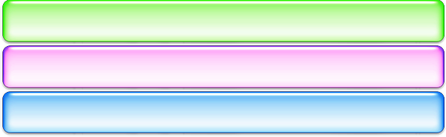
Why use Hyperledger Composer?
Blockchains provide a low-level interface for business applications
Smart contract code run on a distributed processing system
Inputs go into an immutable ledger; outputs to a data store
Applications are built on top of a low level of abstraction
Business Application
Hyperledger Composer
A suite of high level application abstractions for business networks
Emphasis on business-centric vocabulary for quick solution creation
Features
Model your business network, test and deploy
Applications use APIs to interact with a business network
Integrate existing systems of record using loopback/REST
Hyperledger Composer
Hyperledger Fabric
Open Tools, APIs and libraries to support these activities
Exploits Hyperledger Fabric blockchain technology
Fully open and part of Linux Foundation Hyperledger

Slide 53
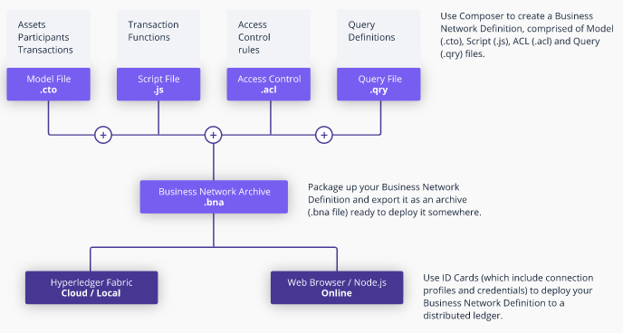
How to use Hyperledger Composer?
You can use Hyperledger Composer to quickly model your current business network, containing your existing assets and the transactions related to them; assets are tangible or intangible goods, services, or property.
As part of your business network model, you define the transactions which can interact with assets.
Business networks also include the participants who interact with them, each of which can be associated with a unique identity, across multiple business networks.

Slide 54
How does Hyperledger Composer work in practice?
For an example of a business network in action; a realtor can quickly model their business network as such:
Assets: houses and listings
Participants: buyers and homeowners
Transactions: buying or selling houses, and creating and closing listings
Participants can have their access to transactions restricted based on their role as either a buyer, seller, or realtor. The realtor can then create an application to present buyers and sellers with a simple user interface for viewing open listings and making offers.
This business network could also be integrated with existing inventory system, adding new houses as assets and removing sold properties.
Relevant other parties can be registered as participants, for example a land registry might interact with a buyer to transfer ownership of the land.

Slide 55




Benefits of Hyperledger Composer
Increases understanding | Saves time | Reduces risk | Increases flexibility
Bridges simply from business concepts to blockchain | Develop blockchain applications more quickly and cheaply | Well tested, efficient design conforms to best practice | Higher level abstraction makes it easier to iterate

Slide 56














An Example Business Network – Car Auction Market
Vehicle Listing
Listing ID • State
Reserve Price• Offers
Description • Linked to Vehicle
Vehicle
VIN
Owner
Owner
Auctioneer
Buyer
3
App
App
2
Existing system
1
close bidding
App
sell car
Business Network Transactions Participants Registries Identity Assets
builds on
offer bid
Transactions
Offer
Close Bidding
Vehicle registry Listings registry
Hyperledger Composer
Peers Chaincode Consensus World State
Hyperledger Fabric
Counterparties outside the business network
DVLA
Insurer
Notes:
Driver and Vehicle Licensing Agency (DVLA)

Slide 57
Conceptual Components and Structure of Composer
Business Network is defined by Models, Script Files, ACLs and Metadata and packaged in a Business Network Archive
Solution Developer models the business network, implements the script files that define transaction behaviour and packages into a business network archive
D
Solution Administrator provision the target environment and may manage deploy
A
Business Network Archive
Script File ACLs
Models
Metadata

Slide 58






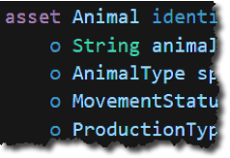




















Extensive, Familiar, Open Development Toolset
composer-client
composer-admin
Data modelling
JavaScript business logic
Web playground
Client libraries
$ composer
Swagge r
Existing systems and
data
Editor support
CLI utilities
Code generation

Slide 59
Topics
Blockchain Architecture
Blockchain Fabric Development
Blockchain Components
Blockchain Operations
Hyperledger Composer
Notes:
https://www.ibm.com/cloud/architecture/architectures/blockchainArchitecture

Slide 60


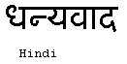

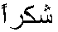

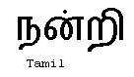

END !
Hindi
Traditional Chinese
Thai
Gracias
Russian
Thank You
Spanish
Obrigado
English
Danke
Brazilian Portuguese
Arabic
Grazie
Merci
German
Italian
Simplified Chinese
French
Japanese
Korean
Notes:
60

